Slide 1
INORGANIC CHEMICAL TECHNOLOGY
PROJECT ON SULFUR

Slide 2
PROPERTIES OF SULFUR
Chemical Name: Sulfur
Chemical Formula: S₈
Family Group 16 (VIA)
Chalcogen Family
Physical State: Solid
Appearance: Yellow colored lumps, crystals, powder, or f Formed shape
Odour: Odourless , or faint odour of rotten eggs
if not 100% pure
Allotrophy: rhombic , monoclinic , polymeric
Solubility In Water: Insoluble
Boiling Point: 832ºF (444ºC)
Freezing/Melting Point: 230-246ºF (110-119ºC)
Flashpoint: 405^{O}F (207.2ºC)

Slide 3
SULFUR ORES
Sulfur also occurs in a number of important minerals. Some examples are
Barium sulfate (BaSO₄)
strontium sulfate (SrSO₄)
cinnabar (HgS)
lead sulfide (PbS)
pyrites, or iron sulfide (FeS₂)
sphalerite, or zinc sulfide (ZnS)
antimony sulfide (Sb₂S₃).
Many ores are compounds of a metal and oxygen or a metal and sulfur. Compounds that contain two elements, one of which is sulfur, are called sulfides. For example, a beautiful gold-colored mineral is called pyrite, or "fool's gold," because it looks so much like real gold. Pyrite is iron sulfide (FeS₂).

Slide 4
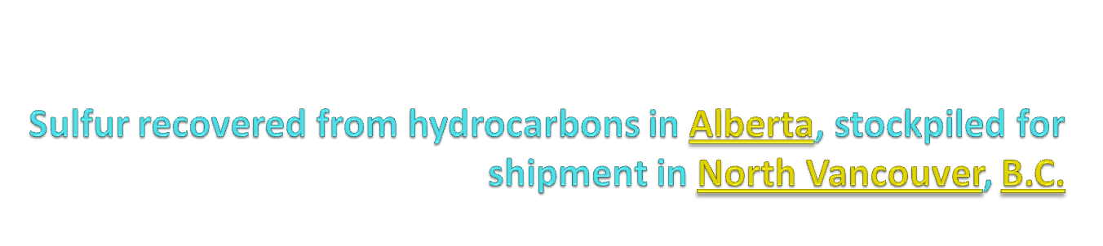
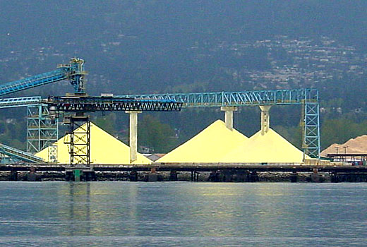

Slide 5
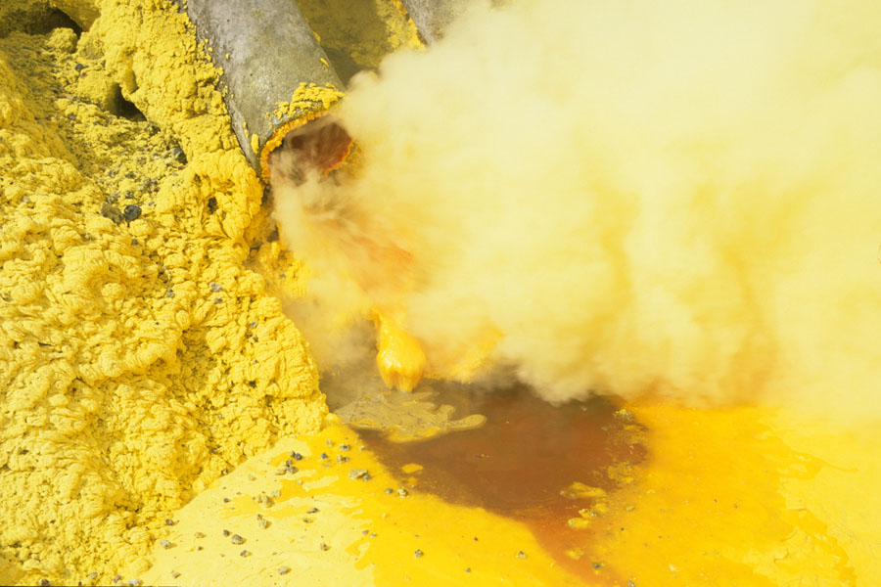

Slide 6
SULFUR PRODUCTION
PROCESSES
FRASCH PROCESS
-Elemental sulfur mining from salt domes.
CLAUS PROCESS
- hydrogen sulfide conversion from natural gases and industrial gases
FINNISH PROCESS
- Iron pyrites from Amjhore in Bihar state

Slide 7
FRASCH PROCESS
RAW MATERIALS - sulfur deposits in salt domes
- large supply of hot water
QUANTITATIVE REQUIREMENTS
BASIS - 1 ton of sulfur
Water - 6 tons
Dome operating capacity
- 500-8000 tons/day of sulfur

Slide 8
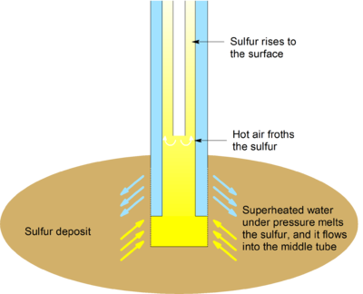
FRASCH PROCESS
MOLTEN SULFUR
COMPRESSED
HOT AIR
Treated hot water
( l6O-l8O ˚C)

Slide 9
MAJOR ENGINEERING PROBLEMS
Heat transfer in melting and shipping operations
Finding suitable sources of treated water
corrosion

Slide 10
CLAUS PROCESS
RAW MATERIALS
- H₂S from natural gas and petroleum streams.
CHEMICAL REACTIONS
2 H₂S + 3 O₂ → 2 SO₂ + 2 H₂O
4 H₂S + 2 SO₂ → S₆ + 4 H₂O
QUANTITATIVE REQUIREMENTS
BASIS - 1 ton sulfur
H₂S -1.2 tons
Air - 1700 Nm³
Plant capacity – 20-600 tons/day
Al₂O₃

Slide 11
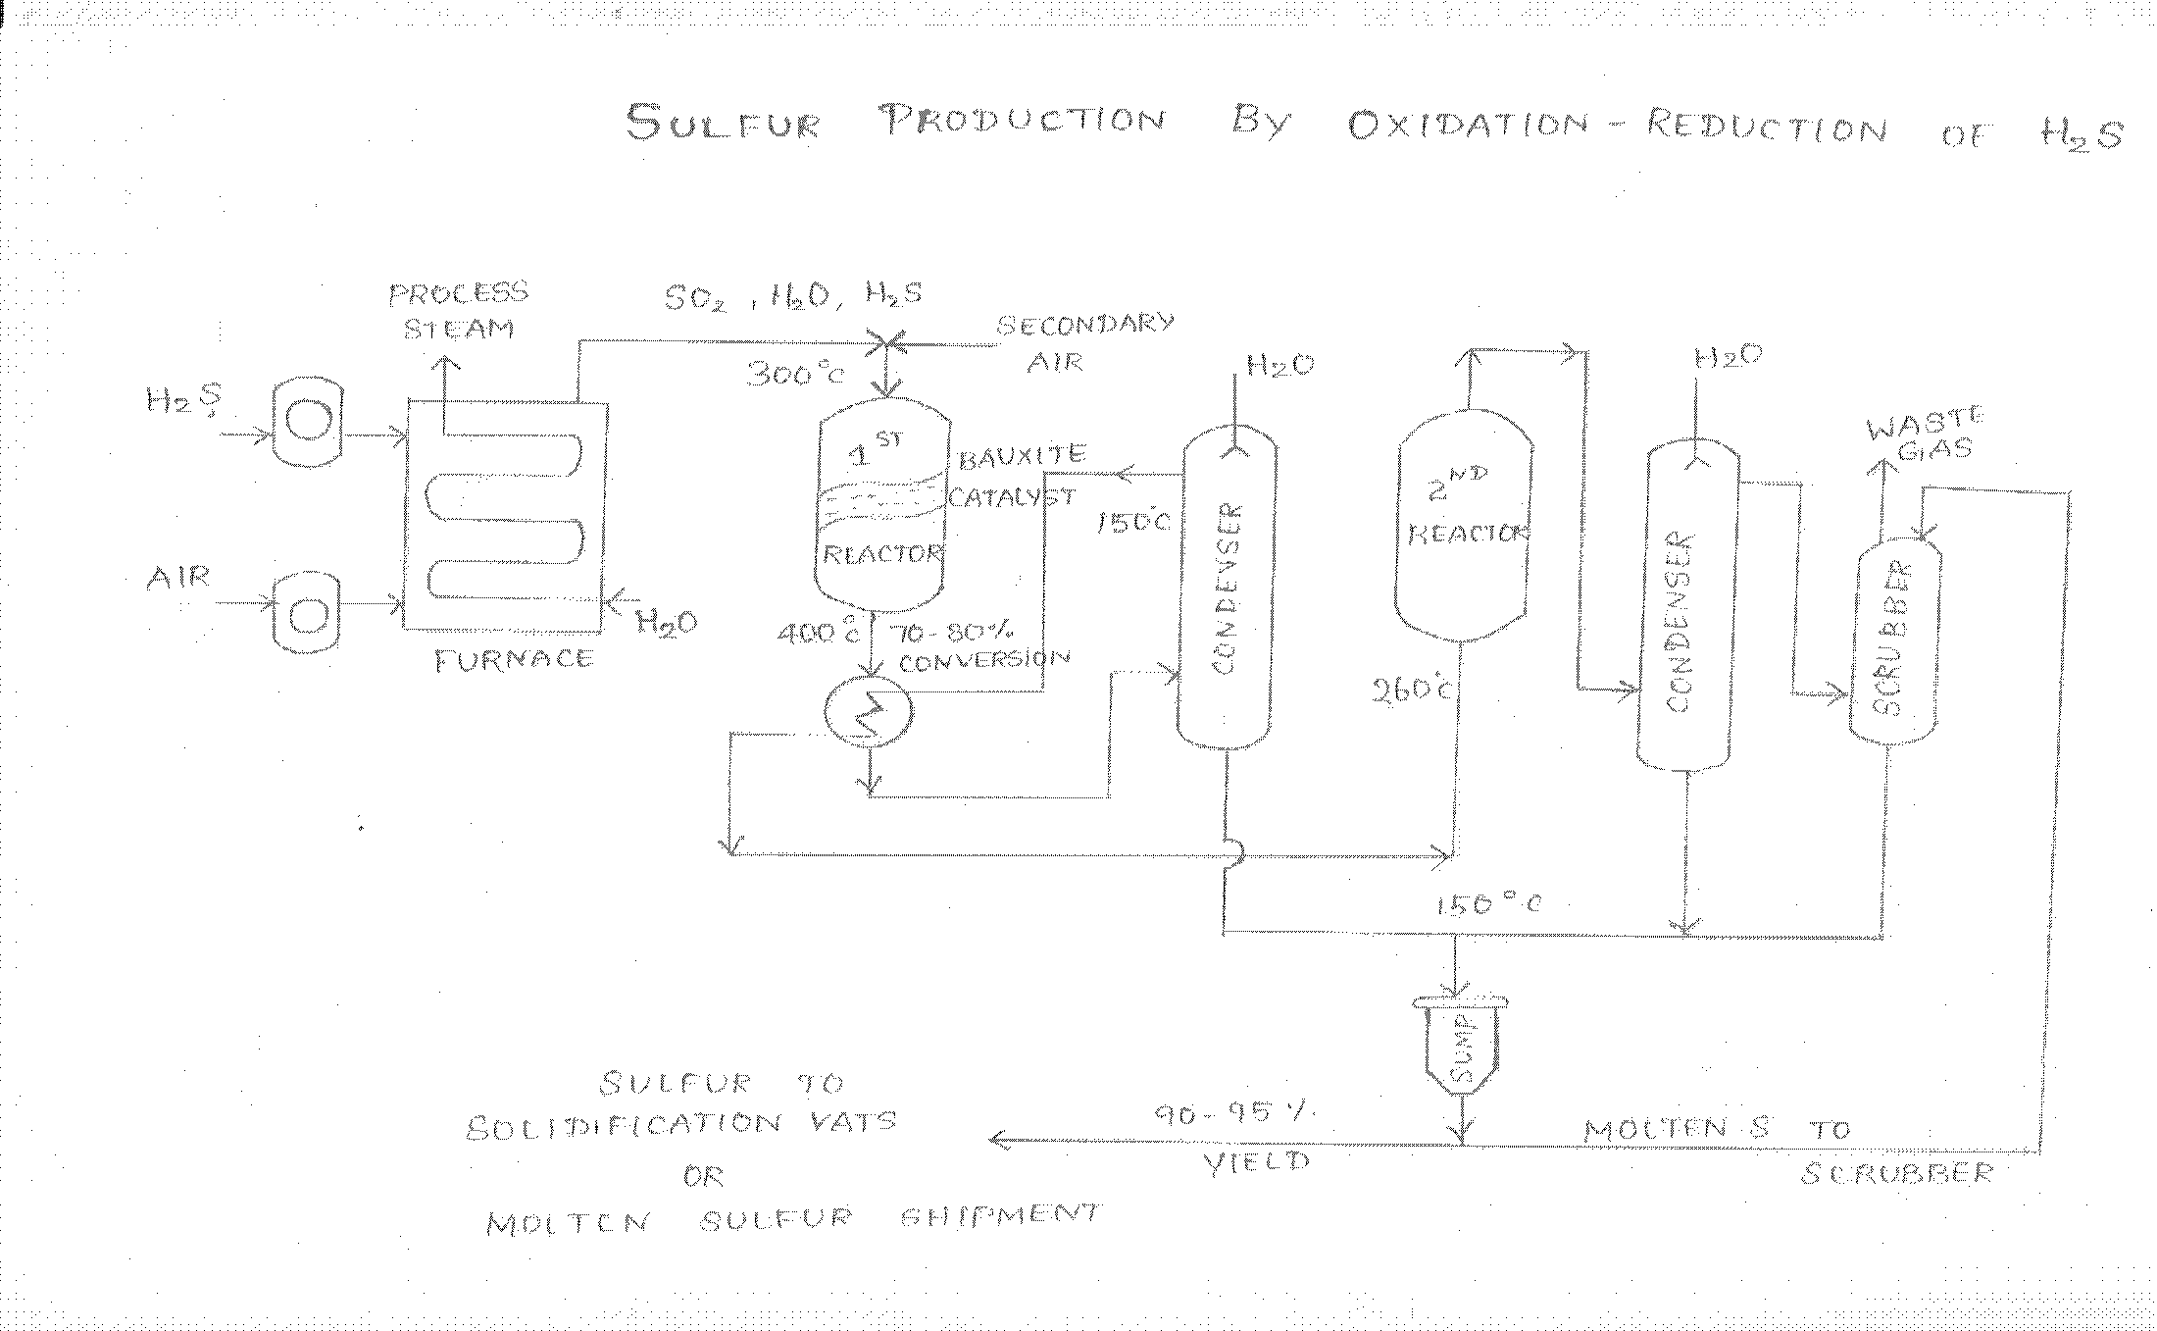

Slide 12
MAJOR ENGINEERING PROBLEMS
Two stage reactor design
Heat exchange for molten sulfur handling
Corrosion
Final clean-up of stack gases

Slide 13
FINNISH PROCESS
QUANTITATIVE REQUIREMENT
BASIS : 1 ton sulfur
Pyrite ore 4.4 ton
Limestone 0.65 ton
Fuel oil 0.76 ton
Water 25 tons
Electricity 1800 kwh
Co products so₂ -1.2 tons
fe₂o₃-2.8 tons
Electricity-32000 kwh
PLANT CAPACITY - 250 tons/day of sulfur

Slide 14
CHEMICAL REACTIONS
Thermal dissociation
FeS₂ ½ S₂ + FeS
Combustion reaction
C + H+ S+ O₂ SO₂ + H₂S +CO + H₂O
Sulfur recovery from gases – hot stage
2 COS + CS₂ + 2 SO₂ S₆ + 3 CO₂
Sulfur recovery from gases – cold stage
4 H₂S + 2 SO₂ → S₆ + 4 H₂O
SO₂ recovery by roasting
2 FeS + 3_{½} O₂ → Fe₂O₃ + 2SO₂
1300 °c
Al₂O₃
1000 °c

Slide 15
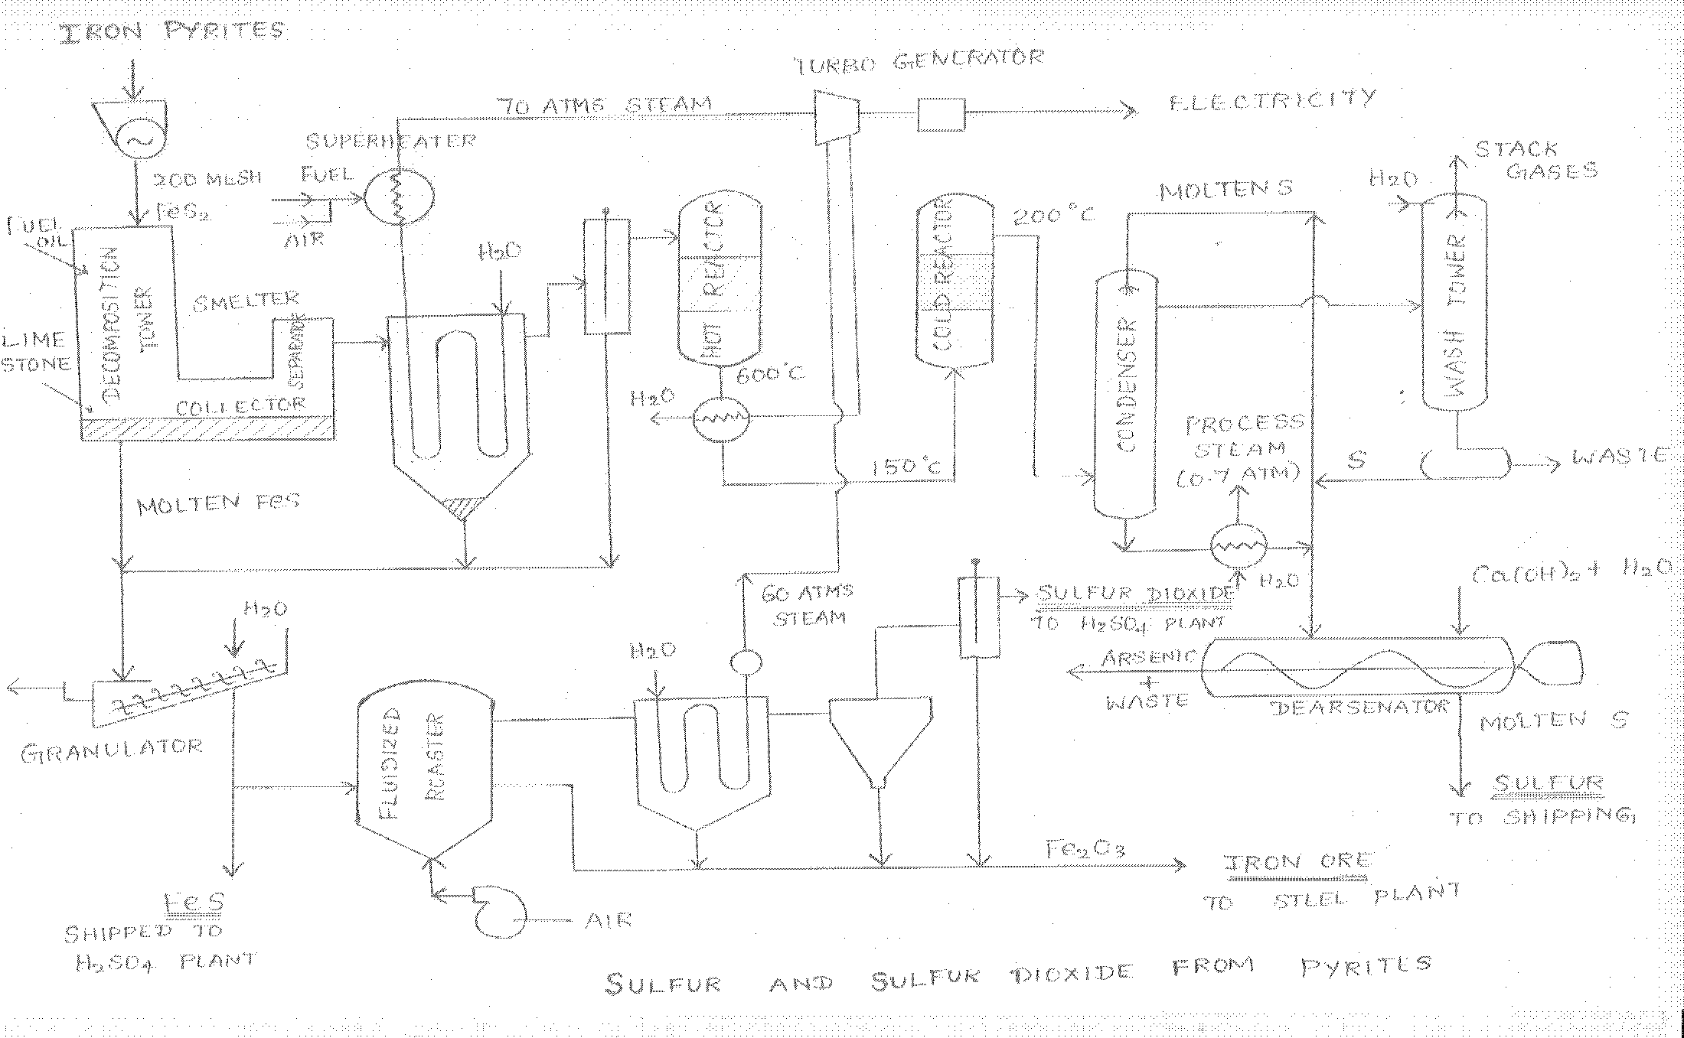

Slide 16
MAJOR ENGINEERING PROBLEMS
Pyrite ore beneficiation
Grinding
Substitution of coal for fuel oil
Gaseous reactions in the smelting furnace
Two-stage catalytic reactor Design
Heat recovery an generation of electric energy

Slide 17
USES OF SULFUR
Manufacture of sulfuric acid
Fertilizers
Fungicides
Chemicals and explosives
Dyestuffs
Petroleum refining
Vulcanization of rubber
Wood and paper products.

Slide 18

H₂O
H₂O
H₂S, H₂O, SO₂
AIR
PROCESS STEAM
300 °C
WASTE GAS
H₂S
1 ^{ST} REACTOR
BAUXITE CATALYST
2 ^{ND} REACTOR
150 °C
CONDENSER
AIR
H₂O
400 °C
CONDENSER
FURNACE
260 °C
SCRUBBER
150 °C
SUMP
MOLTEN SULFUR
TO
SCRUBBER
MOLTEN SULFUR SHIPMENT
OR
SULFUR TO SOLIDIFICATION VATS

Slide 19
THANK U

